Slide 1

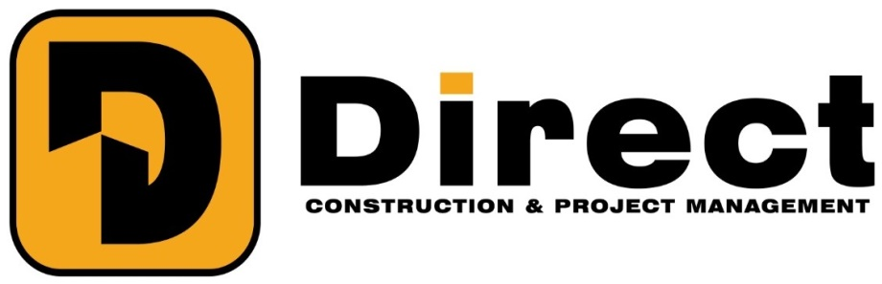

Slide 2

Trust Excellence Continuation Vision

Slide 3

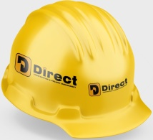
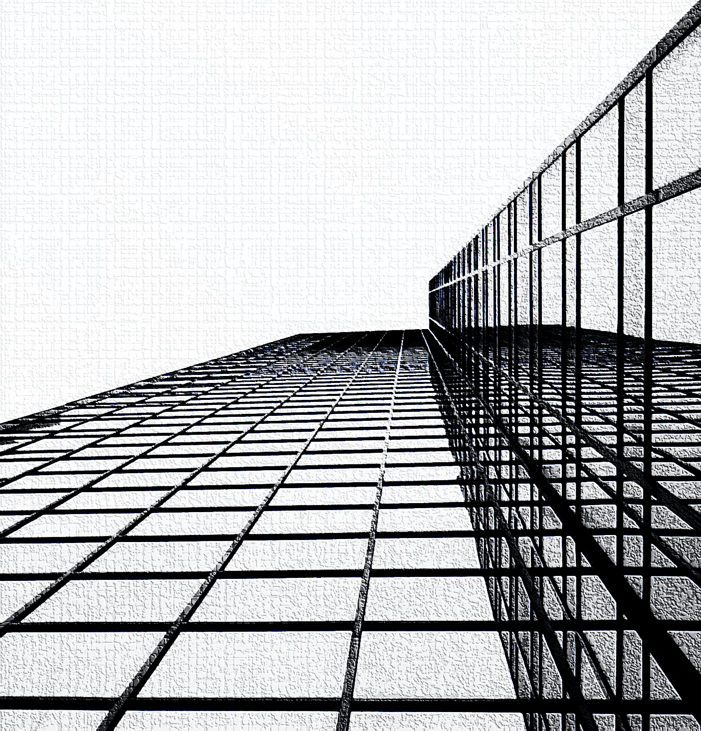


3
Company Profile
About Us
DIERCT Construction and Project Management is a group of highly qualified and experienced professionals committed to delivering high-quality projects and quality engineering services while providing multi-disciplinary technical solutions to meet our clients' satisfaction.
Together, we embrace our core values of trust and consistency that have allowed us to complete numerous projects in the hospitality, healthcare, industrial, education, commercial and residential sectors.
At the heart of these projects is a commitment to sustainability, achievement and leadership. We are at the forefront of delivering healthy, efficient and cost-effective LEED certified projects that help build and develop equitable and green communities.
We build our business on responsibility, respect and forward-thinking. With our partners and customers, we are proud to work together to build the communities of the future.
We are a multi-purpose company that encourages diversity and authenticity in the workforce to achieve common goals.
Creating a well-defined sphere in which different ideas can be freely expressed in pursuit of a consistent goal is essential to creating a harmonious and receptive working environment, an environment that has enabled DIERCT to embrace various innovations.
Our Sector
Our business activity extends to all fields of all metal, concrete and electromechanical works, including but not limited to:
Project management
Concrete works
Pre-Construction Services
Value Engineering
MEP Construction Management
Design-Build MEP Services
Engineering Solutions
Facility Management
Electrical, Mechanical & Plumbing Works\
Fire fighting works
Testing & Commissioning, Re-Commissioning & Retro-Commissioning Services for MEP Systems
DIERCT operates with the highest efficiency and according to the latest technologies in compliance with international standards of quality, security and safety. we use
Trained and experienced staff to implement and deliver projects While adhering to the terms and conditions of the contract and preserving the environment.
Our Policies
Service
Industrial
Construction
Suppliers

Slide 4

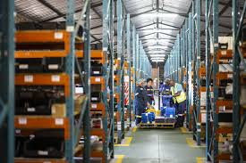


4
Company Profile
Our Sectors
Main Constructing | AC Condition | Flanged | Value Engineering
MEP Constructing | Ventilation | Bolts | MEP Management
Residential Construction | Vibration Isolator |  | Facility Management
Commercial Construction | Pre-Isolated pipe
Industrial Construction | Flanged
Infrastructure Construction | Cold & Heating Solar System
Construction
Suppliers
Industrial
Service

Slide 5
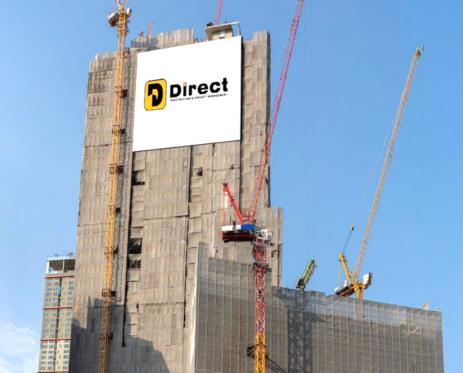
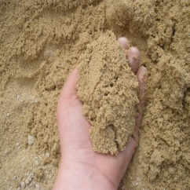
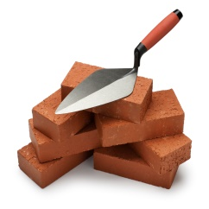
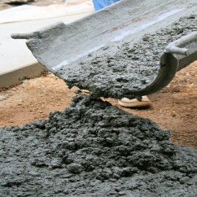
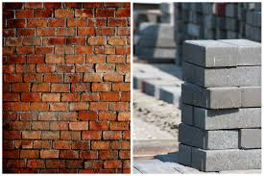
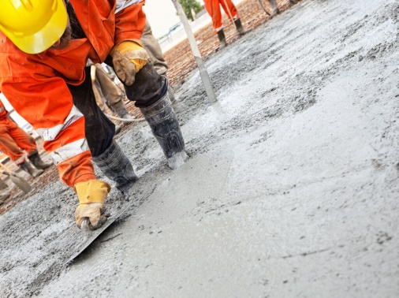
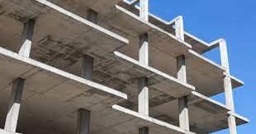
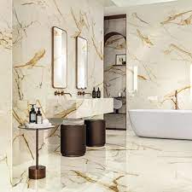

Company Profile
6
It is considered the first pillar in the company's sectors, which enjoys a strong team in this sector to provide the desires of customers with buildings of various purposes and the sectors represented in the projects
And it was established to build many structures and develop facilities, properties, housing, sidewalks, roads, highways and other construction projects. When working on a project, a construction company must be prepared for many activities
Residential Construction,
Commercial Construction,
Industrial Construction,
Infrastructure Construction
Direct
Construction
Concrete constructions
Foundation works
Walls
Columns and ceilings
the stairs
The beams
Tiles
Brick
Concrete mix design...
Private and individual construction works Civil works extend to cover the construction of buildings and their infrastructure, concrete buildings and finishing works...

Slide 6
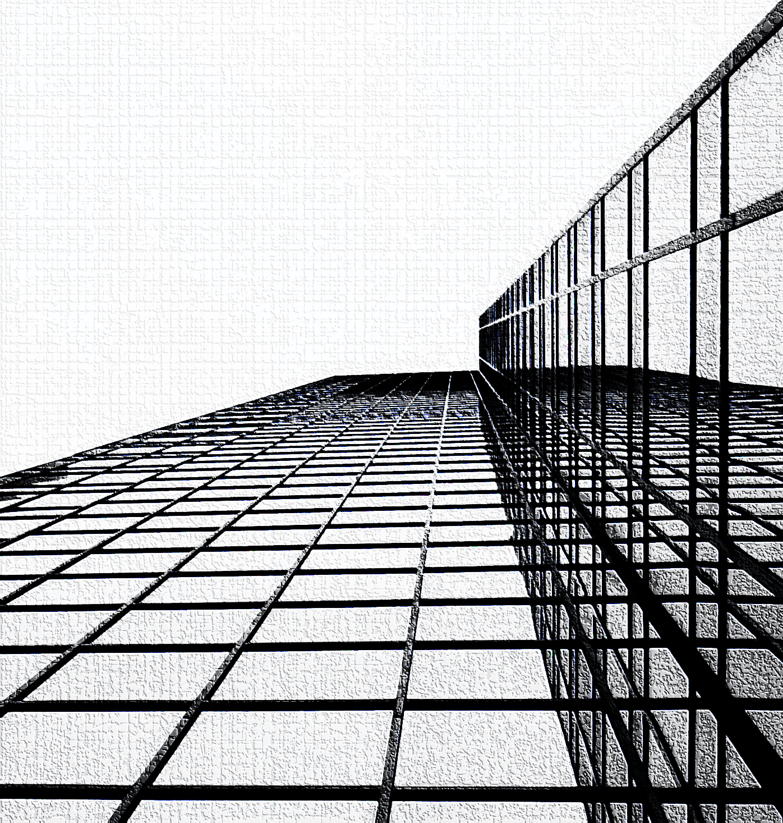
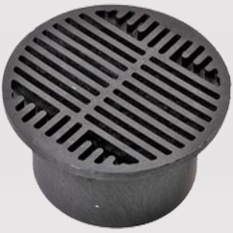
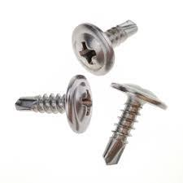
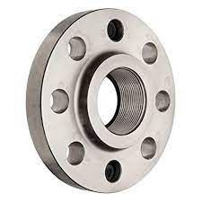
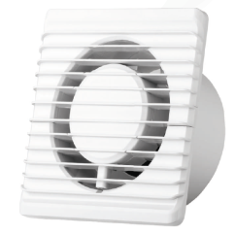
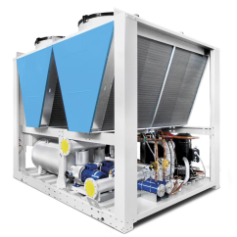
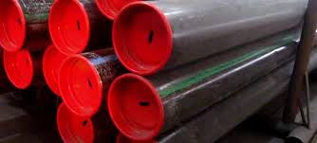
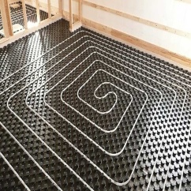
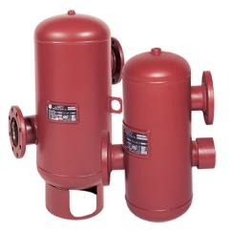
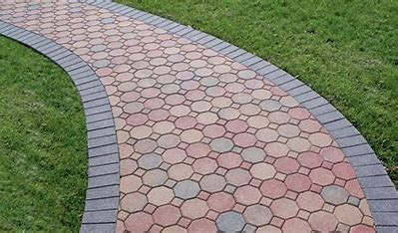
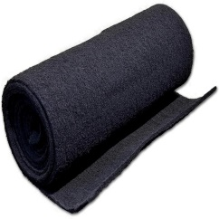
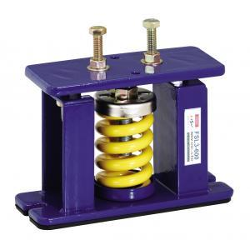
5
Company Profile
The supply sector in the company is considered one of the most important sectors that serve customers in certain sectors, including the requirements of the electromechanical sector and the sector specialized in general contracting
We are proud and optimistic to announce that we have had the honor of becoming the sole official distributors for many companies specialized in many fields of the company, especially supplies and the most famous in the field of air conditioning and ventilation in Egypt.
HVAC Equipment
Air Condition
Ventilation
Vibration Isolator
Pre-Isolated pipe
Flanged
Cold & Heating Solar System
Direct
Suppliers
Materials
Concrete
brick
Tiled
Interlock
Insulators
Cement
Sand

Slide 7
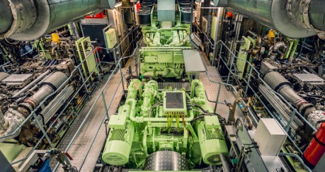
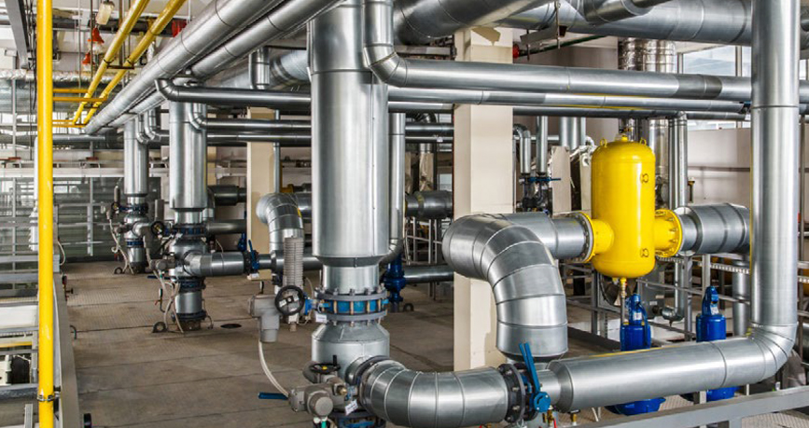
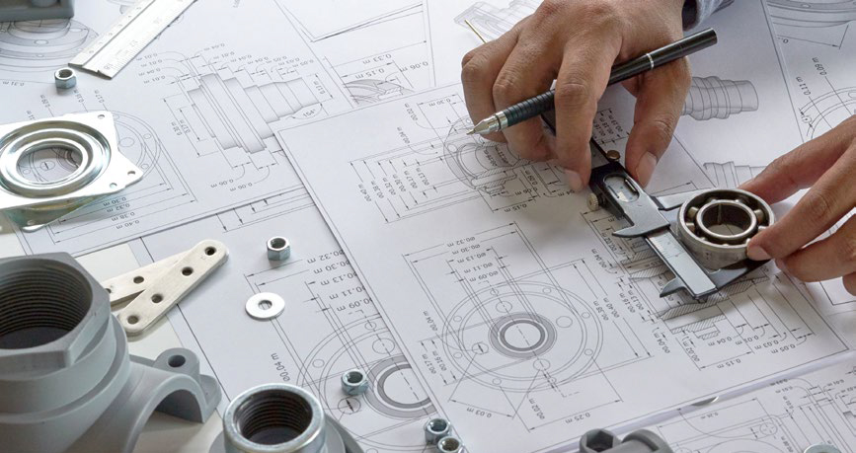
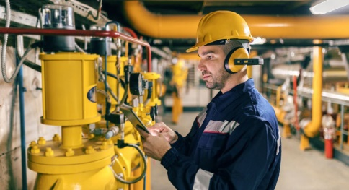
8
Company Profile
Electrical, Mechanical & Plumbing Works
Direct offers comprehensive electrical, mechanical, plumbing, and firefighting work. Our services include the selection and installation of efficient heating, cooling, ventilation (HVAC) systems, including water cooling/heating, humidity control or air filtration, underfloor heating, chilled beam systems, lift well and stairwell pressurization systems. Our team of engineers can also integrate efficient alternatives to traditional systems such as heat pumps and evaporating cooling.
Value
Engineering
Our team works closely with clients to review the MEP engineering approach and to explore alternative ways of achieving clients’ goals. We do this by analyzing the MEP functions of a project including reliability, safety, efficiency, and performance, and by integrating environmentally-sound and energy-efficient materials and best practices. We can also help choose the best and most suitable equipment in today’s marketplace.
MEP Construction Management
MEP construction management is integral to the success of any project.
DIRECT manages and monitors the overall
progress of all MEP aspects of a project’s delivery, starting from tendering, procurement, testing and commissioning, all the way
to client delivery.
The process also includes managing overall costs, supervising on-site teams, coordinating logistics and material delivery, and ensuring that the work meets the quality standards and requirements of the clients.
Facility
Management
Direct supports clients with bespoke professional facility management and HVAC services. Our offerings include providing experienced on-site facility management teams backed by a strong network of technical, administrative, and accounting experts. Depending on each facilities’ requirements, we can design a management plan specifically tailored to the requests of each client, including round-the-clock support, web-based service requests, vendor oversight and sourcing, monthly reporting, and providing suggestions for reducing the costs of property operations.
DIRECT Service is a newcomer in the company's sectors, and it works to meet the desires of customers in engineering solutions in our modern age full of inventions that serve humanity
And we have endeavored to use the most modern technologies and products of a distinctive nature, with the provision of well-trained workers to represent the company in the best way.
Direct
Service

Slide 8
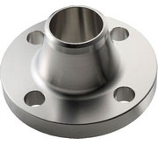
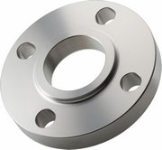
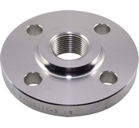
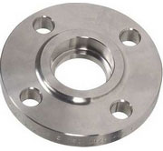
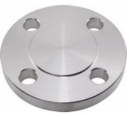
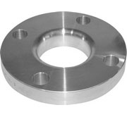
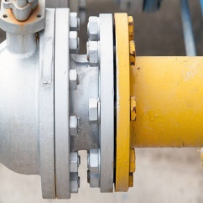
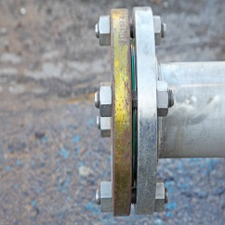
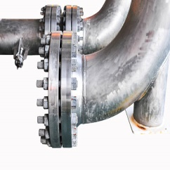
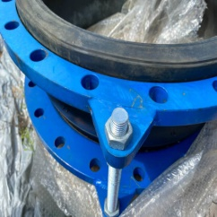
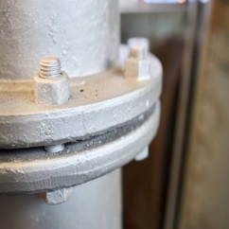
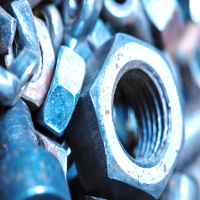
7
Company Profile
DIERCT for manufacturing is one of the sectors of the company to serve the pipeline sector of all kinds, and we produce more than one product
such as
Flange is a means of connecting pipes, valves, pumps and other equipment to form a piping system. It also provides easy access for cleaning, checking or adjusting. Flanges are usually welded or screwed. Flanged joints are manufactured by joining two flanges with a gasket between them to provide a seal...
Select the rating to display the flange dimensions: 150, 300, 400, 600, 900, 1500, 2500
Direct
Industrial
Lap Joint FLANGE
Welding Neck FLANGE
Slip On FLANGE
Socket Weld FLANGE
Blind FLANGE
Threaded FLANGE
Welding Neck
Slip On
Threaded
Socket Weld
Blind FLANGE
Lap Joint

Slide 9


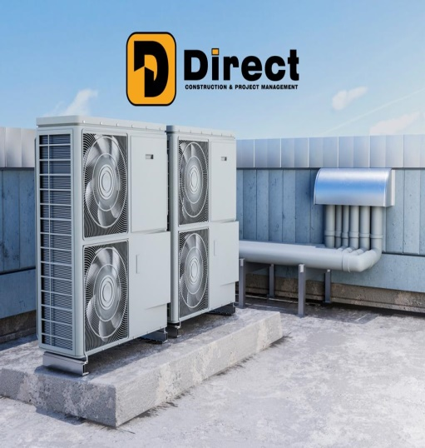
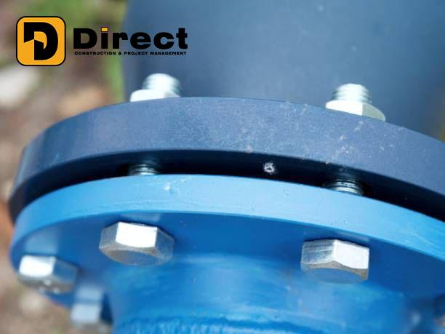
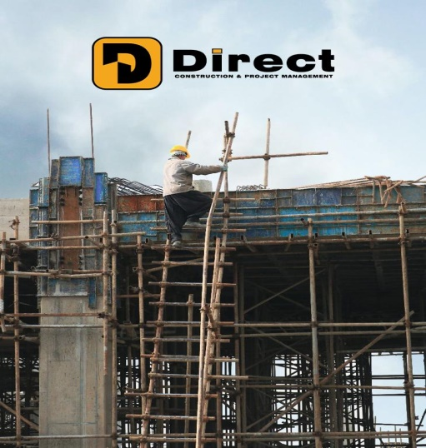
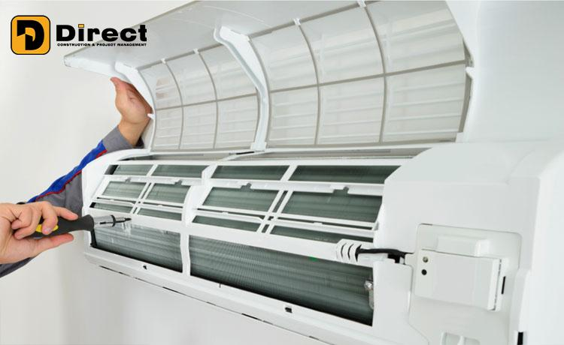

Our Reference

Slide 10

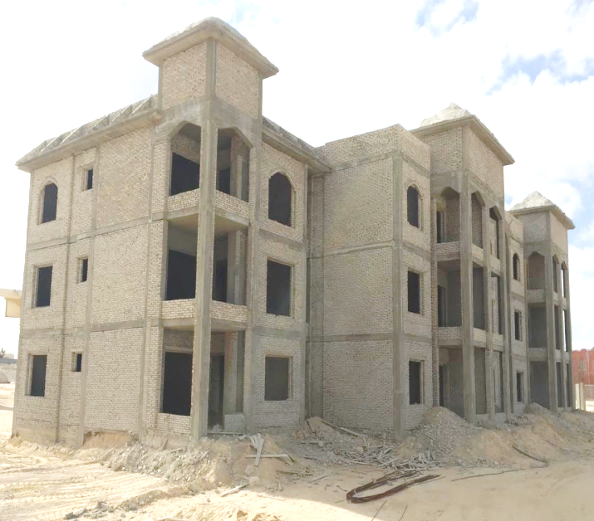
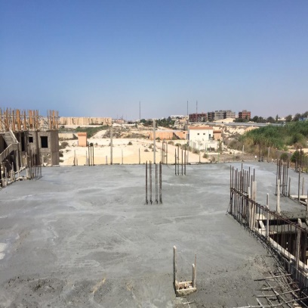
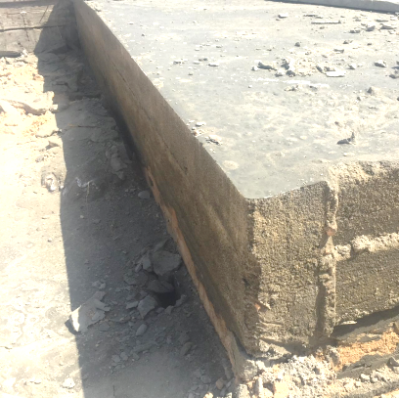
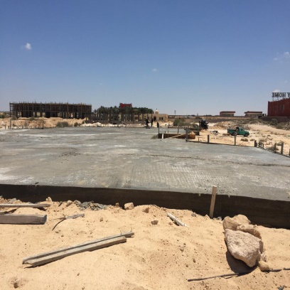
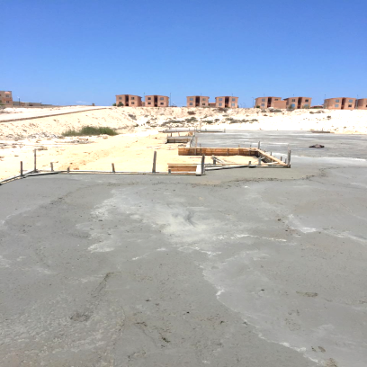
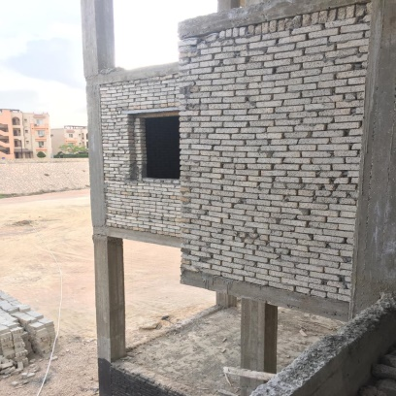



10
Company Profile
Main Contracting
Paradise Beach (Taxes Village),
K64, North Coast
Completion of the second stage
Construction and finishing of 10 buildings
Ground floor, three floors
Flat building 750 square meters

Slide 11








11
Company Profile
Main Contracting
Replacing and developing the
Civil Protection Administration
Sharm El Sheikh
Ministry of Interior
General contractor
SESTIL Trading and Marketing

Slide 12






12
Company Profile
KRAFT FOODS EGYPT
Location : 10th of Ramadan Egypt
Owner : Kraft
Consultant : EMG Consultant
Scope of Work
Supplying and installing fire systems and air conditioning systems with a capacity of 150 tons of cooling & Air Handling Unit & Fan Coil Unit
Happy Sweet Food
Location : Cairo - Egypt
Owner : H.Sweet Food Industries
Consultant : Turkish Consultant
Scope of Work
Designing and restructuring the administrative building of the factory, including production halls and storage sheds Units operated by evaporative cooling system with a capacity of 300 tons
Lafarge Factory
Location : 10th of Ramadan Egypt
Owner : Redecam Egypt Limited
Consultant : ITALY Consultant
Scope of Work
Industrial Water Cooled Chiller Supplying a chiller w/cooling unit that serves the factory’s capacity of 25 tons for complete cooling with pumps, valves , expansion tank.
MILANO Factory
Location : October - Egypt
Owner : Milano factory
Consultant : Asmakna Consultant
Scope of Work
Redesign and Supplying and installing fire systems and air conditioning systems with a capacity of 150 tons of cooling & Air Handling Unit & Fan Coil Unit
El – HIKMA Factory
Location October - Egypt
Owner : El – HIKMA Factory
Consultant : Dora Consultant
Scope of Work
Redesign and restructuring of the factory's administrative building, including meeting rooms and hospitality
Factory Project

Slide 13





13
Company Profile
Silver Mall
Location : Cairo - Egypt
Owner : Silver Mall
Consultant : Eng Department
Scope of Work
Supplying & Installing of central air conditioning in the mall with a capacity of 100 tons of cooling (Condensing Unit + Air Handling Unit + Ventilation System )
El Alfy Mall
Location : Cairo - Egypt
Owner : El Alfy Co
Consultant : Eng Department
Scope of Work
Supplying & Installing all duct sheet works for air condition and ventilation works. all works about 12 ton
Technology Mall
Location : Nasr city Egypt
Owner : El Shrook Co
Consultant : Eng Department
Scope of Work
Supplying & Installing of central air conditioning in the mall with a capacity of 100 tons of cooling (Condensing Unit + Air Handling Unit + Ventilation System )
Maxim Mall
Location : Fifth Settlement-Egypt
Owner : Royal Maxim
Consultant : Dora Consultant
Scope of Work
Supplying & installing the ventilation line for Some shop and corridor. Exhaust fan ( 3000 cfm ) + ( 4500 cfm )
Mazloum Mall
Location : North Coast
Owner : Royal Maxim
Consultant : Eng Department
Scope of Work
Supplying & installing the ventilation line for Some shop and corridor. Exhaust fan & DX Unit
Mall Project

Slide 14




14
Company Profile
Post Office Building
Location : Administrative Capital
Owner : Post Office
Consultant : MED Consultant
Scope of Work
Supplying & Installing all duct sheet works for air condition and ventilation works. all works about 120 Ton
Tower Bay
Location : Cairo - Egypt
Owner : Tower Bay
Consultant : Eng Department
Scope of Work
Preparing & equipping all air conditioning works for residential apartments . Preparing & equipping all sanitary works as well as extending water & drainage pipes
HSBC Bank
Location : Mohaddessin – Egypt
Owner : HSBC Bank
Consultant : HSBC Bank
Scope of Work
Supplying & installing the ventilation line for Some shop and corridor. exhaust fan dx unit total 80 ton used kitisen
HSBC Bank Kitchen
Location : Cairo - Egypt
Owner : HSBC Bank
Consultant : Eng Department
Scope of Work
Supplying & Installing all sheet works (stainless steel) for the bank’s kitchen on the ground floor, along with supplying & installing ventilation works
Faros University
Location : Alex - Egypt
Owner : Faros University
Consultant : MED Consultant
Scope of Work
Supplying & Installing of central air conditioning with a capacity of 125 tons of cooling (Condensing Unit + Air Handling Unit + Ventilation System )
Building Project

Slide 15





15
Company Profile
R & D Building
Location : Administrative Capital
Owner : R & D co
Consultant : MED Consultant
Scope of Work
Supplying & Installing all duct sheet works for air condition and ventilation works. all works about 120 Ton
PETROBEL Office
Location : Cairo – Egypt
Owner : El Alfy Co
Consultant : Eng Department
Scope of Work
Preparing & equipping all air conditioning works for residential apartments . Preparing & equipping all sanitary works as well as extending water & drainage pipes.
Arab Medical Sys Co
Location : October - Egypt
Owner : Arab Medical
Consultant : EMDEG Consultant
Scope of Work
Supplying & Installing all duct sheet works for air condition and ventilation works. all works about 80 Ton
Sumed Petro Jet
Location : Cairo - Egypt
Owner : HSBC Bank
Consultant : Eng Department
Scope of Work
Supplying & Installing all sheet works (stainless steel) for the bank’s kitchen on the ground floor, along with supplying & installing ventilation works
Abu Qir Petroleum
Location : Cairo – Egypt
Owner : Faros University
Consultant : MED Consultant
Scope of Work
Supplying & Installing of central air conditioning with a capacity of 125 tons of cooling (Condensing Unit + Air Handling Unit + Ventilation System )
Building Project

Slide 16





16
Company Profile
Nour El Din Boat
Location : Luxor city
Owner : Nour El Din
Consultant : Eng Department
Scope of Work
Supplying & Installing all duct sheet works for air condition and ventilation works.
Horizon Egypt
Location : Luxor city
Owner : Nour El Din
Consultant : Eng Department
Scope of Work
Preparing & equipping all air conditioning works for residential apartments . Preparing & equipping all sanitary works as well as extending water & drainage pipes.
1 ok luxury club
Location : Mohaddessin - Egypt
Owner : 1 ok luxury club
Consultant : Eng Department
Scope of Work
Supplying and installing the ventilation line for Some restaurant FAN COIL UNIT
Khayyam Restaurant
Location : El Zamalik - Egypt
Owner : le pacha 1901
Consultant : Eng Department
Scope of Work
Supplying and installing the ventilation line for Some restaurant FAN COIL UNIT
Le pacha 1901 Restaurant
Location : El Zamalik - Egypt
Owner : le pacha 1901
Consultant : Eng Department
Scope of Work
Supplying and installing the ventilation line for Some restaurant FAN COIL UNIT
Boat Project

Slide 17





17
Company Profile
H & Y Mall
Location : Cairo - Egypt
Owner : Hussein & Youssef Mall
Consultant : Eng Department
Scope of Work
Supplying & Installing of central air conditioning in the mall with a capacity of 200 tons of cooling (Condensing Unit + Air Handling Unit + Ventilation System )
Metro Market
Location : Cairo - Egypt
Owner : Metro Market
Consultant : Eng Department
Scope of Work
Supplying & Installing all MEP works. all works AC Unit + F.F+Electric+Plubing
Technology Mall
Location : Alex Egypt
Owner : El Shrook Co
Consultant : Eng Department
Scope of Work
Supplying & Installing of central air conditioning in the mall with a capacity of 50 tons of cooling (AC Unit + Ventilation System )
Ragab Son
Location : Fifth Settlement-Egypt
Owner : Ragab Son
Consultant : Eng Department
Scope of Work
Supplying & Installing of central air conditioning in the mall with a capacity of 80 tons of cooling (Condensing Unit + Air Handling)
Carrefour
Location : Alexandria
Owner : EMDEG Consultant
Consultant : Eng Department
Scope of Work
Supplying & installing the ventilation line for Some shop and corridor. Exhaust fan & DX Unit camera control room
Shops Project

Slide 18




18
Company Profile
Youth Sports Club in Ahmadi
Location : Kuwait
Owner : General Authority for Youth and Sports
Consultant : Dar Al Khaleej Eng. Consultancy
Scope of Work
provide all Heating, Ventilating and Air Conditioning works complete as per the Contract Documents work of supervising the implementation and approvals of the advisory body with a capacity of 1,800 tons ( CHILLER / AHU / FCU /FANS /COOLING TOWER )
General Organization for Youth Care
Location : Kuwait
Owner : Ministry of Youth
Consultant : BCE AL BENAA CONSULTING
Scope of Work
All installations for central air conditioning in the building, with supervision of implementation, project capacity 1,500 tons ( 2 Chiller + 8 AHU + Fan Section )
MEP Kuwait Project

Slide 19


www.direct-cm.com
EGYPT ADDRESS :
90 MOHAMED GHORAB
HDAEK EL KOBA
CAIRO
EGYPT
FACTORY :
INDUSTRIAL ZOON
TAGAMOA EL KHAMES
CAIRO
EGYPT
Waleed El Hakim
CEO
Mob : +2) 0100 269 9555
waleed.elhakim@direct-cm.com
Mohamed F Abdalla
Business VP
Mob : +2) 0120 007 2241
m.fouad@direct-cm.com

